Slide 1


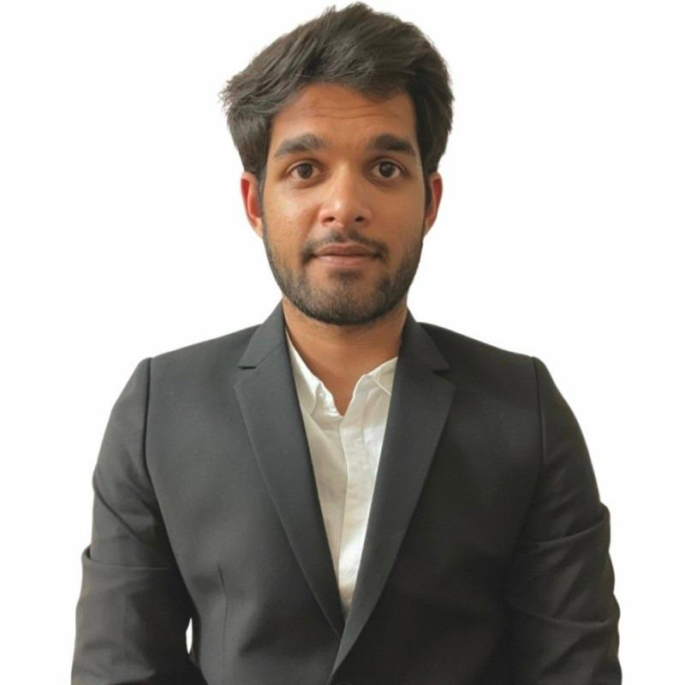
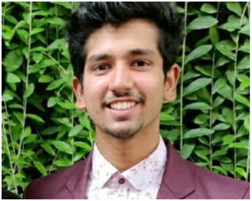





- CAPTION GENIUS -
Comparison of
CNN + LSTM and ResNet + GRU
Approaches for Image Caption Generation
Chaitanya Inamdar
Abhishek Patil
Nishith A
Yashraj Rajput

Slide 2
Walk Through
What the problem is ? | 4. Code sample and the implementation environment
2. What the Data Source ? | 5. Result & Performance comparison of both techniques
3. Technical approaches and algorithms | 6. Conclusion

Slide 3
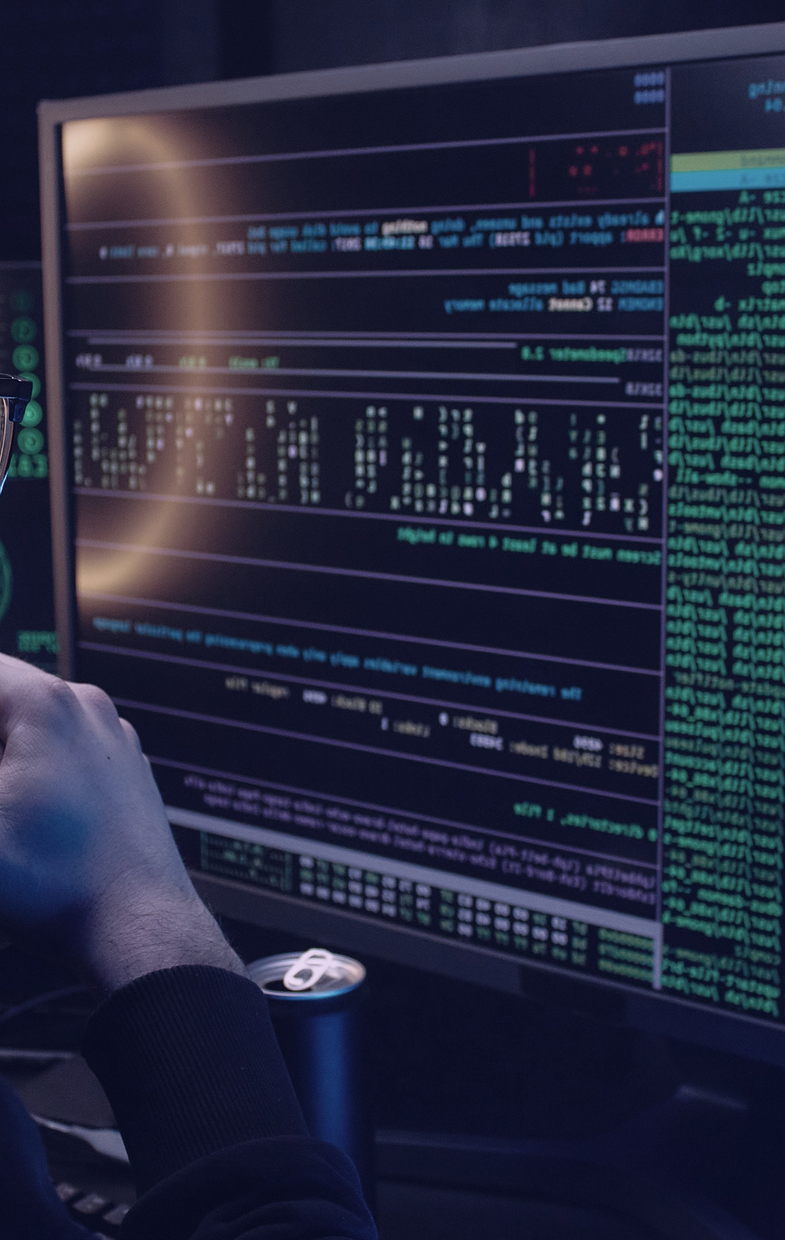
It is important to know the action going on in the image which can prevent various problems by taking care in order to avoid predicated results
In the realm of autonomous cars, where computer vision techniques are used to recognize and track things like other vehicles, pedestrians, and traffic signals, image recognition has a wide range of applications. Image recognition can be used in the healthcare sector to identify irregularities in medical images like X-rays and CT scans, as well as in the retail sector to maintain inventories and track customer behavior.
In general, image recognition offers a solution to the challenge of finding and classifying objects in visual data, enabling automated analysis and decision-making based on visual data.
Problem

Slide 4

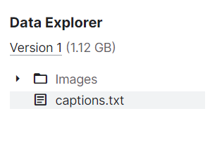

Data Source
Downloaded Flicker 8K dataset from kaggle
The Dataset Comes with caption file
Image format downloaded is jpg

Slide 5
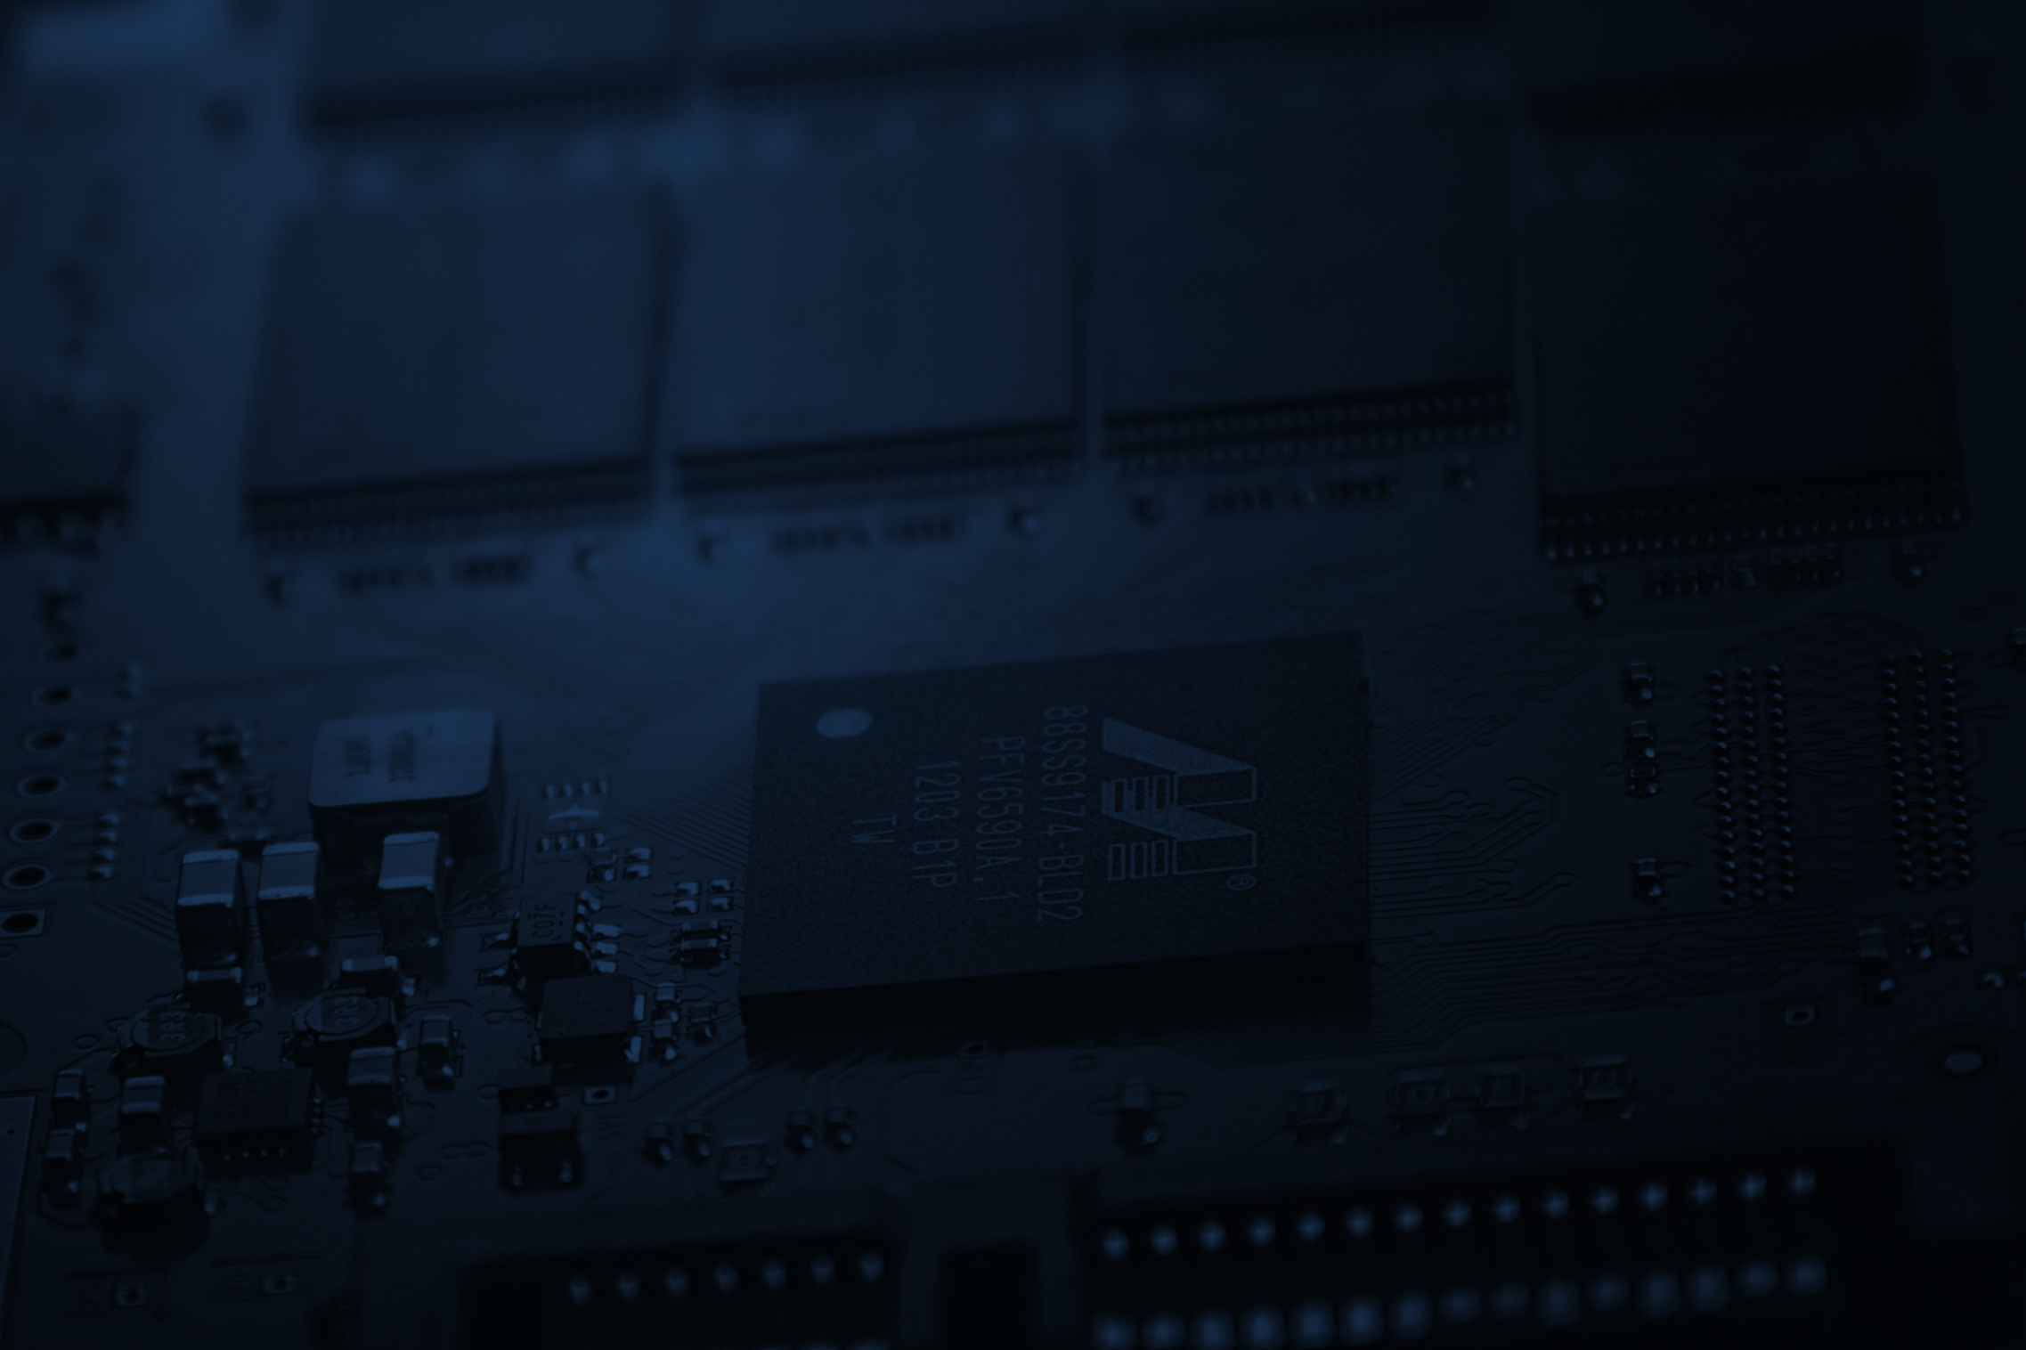
Approach
Data Loading.
Global Data Preprocessing
Image feature extraction using Pre-trained CNN and ResNet Models
Defining models (LSTM and GRU)
Caption Prediction
Evaluation

Slide 6
Global Data Preprocessing
Create mapping of image to captions
Caption text cleaning
Tokenization
Create data generator to get data in batch (avoids session crash)
Split the data into test and train

Slide 7
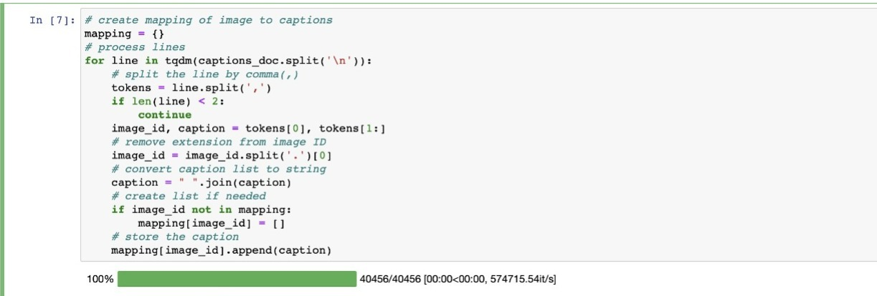
Create mapping of image to captions
This code processes a document containing image captions, and creates a Python dictionary called 'mapping' that stores the image-to-caption pairs.
It iterates through each line in the document and extracts the image ID and corresponding caption text by splitting them by a comma delimiter. It then removes the image file extension from the ID and stores the caption in a list associated with that ID in the 'mapping' dictionary.

Slide 8
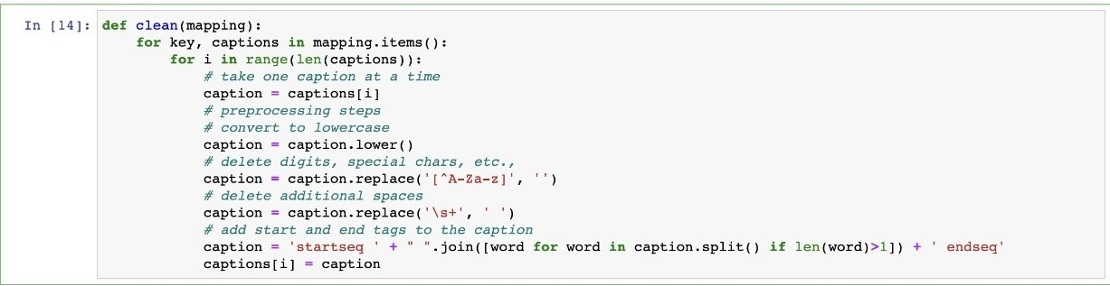
Caption text cleaning
The "mapping" argument is a dictionary where each key represents an image and its value is a list of captions associated with that image.
The function loops through each key-value pair in the "mapping" dictionary.
For each value (list of captions), the function loops through each caption.
For each caption, the function applies some preprocessing steps:
Converts the caption to lowercase.
Removes digits, special characters, etc.
Deletes additional spaces.
Adds "startseq" and "endseq" tags to the caption.
The function modifies the original "mapping" dictionary and returns nothing.

Slide 9
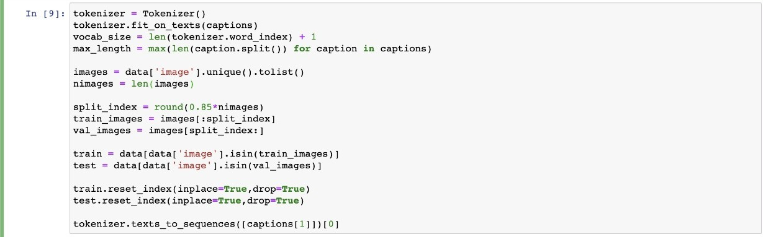
Tokenization
The code creates an instance of the Tokenizer class and fits it on the list of captions.
The number of unique words in the captions is used to determine the vocabulary size.
A list of unique images is created from the 'image' column of a pandas DataFrame.
The number of unique images is counted.
A split index is calculated to split the list of images into training and validation sets.
The train and test Data Frames are created by filtering rows based on the 'image' column.
The train and test Data Frames are reset to a new zero-based index.
The code uses the Tokenizer to convert the second caption in the list of captions to a sequence of integers.
The output is a list of integers representing the words in the caption.

Slide 10
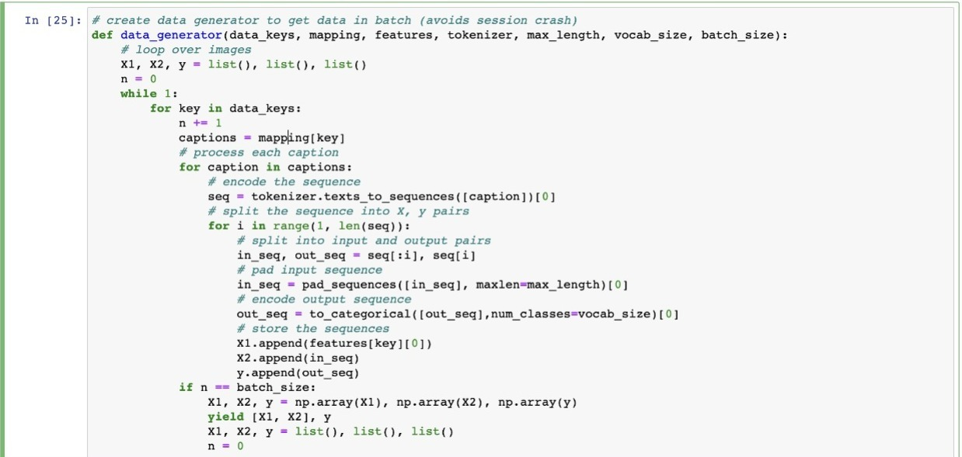
Create data generator to get data in batch (avoids session crash)

Slide 11
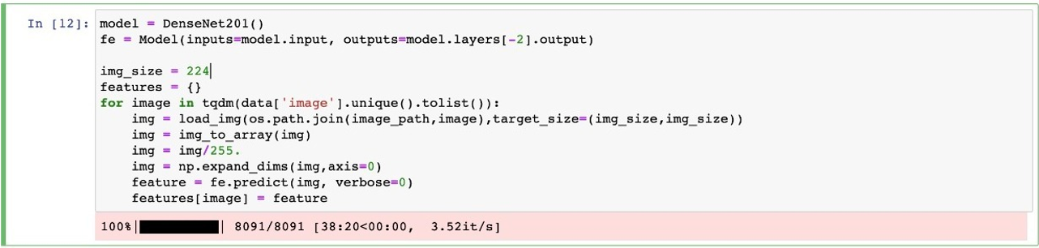
Feature Extraction CNN Model
This code extracts features from images using the pre-trained DenseNet201 which is type of CNN model. It loads images from a specified directory, resizes them to a fixed size (224x224), and normalizes their pixel values between 0 and 1. Then, it applies the feature extraction model up to the second-to-last layer and obtains the output feature vector for each image. These features are stored in a dictionary where the keys are the image filenames. The code utilizes the Keras library for loading and processing the images and extracting features. The tqdm library is used to display a progress bar during the feature extraction process.

Slide 12
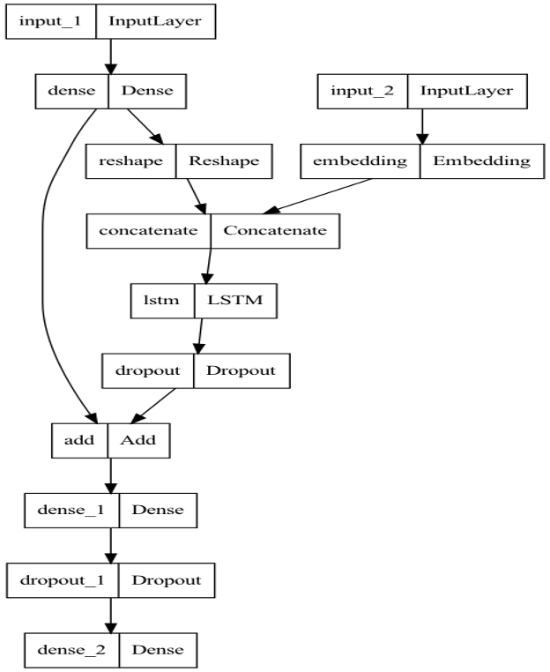
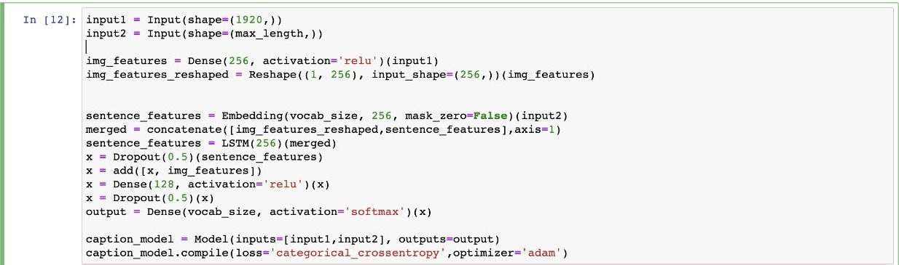
LSTM Model Structure
Total params: 4,316,709
Trainable params: 4,316,709
Non-trainable params: 0

Slide 13
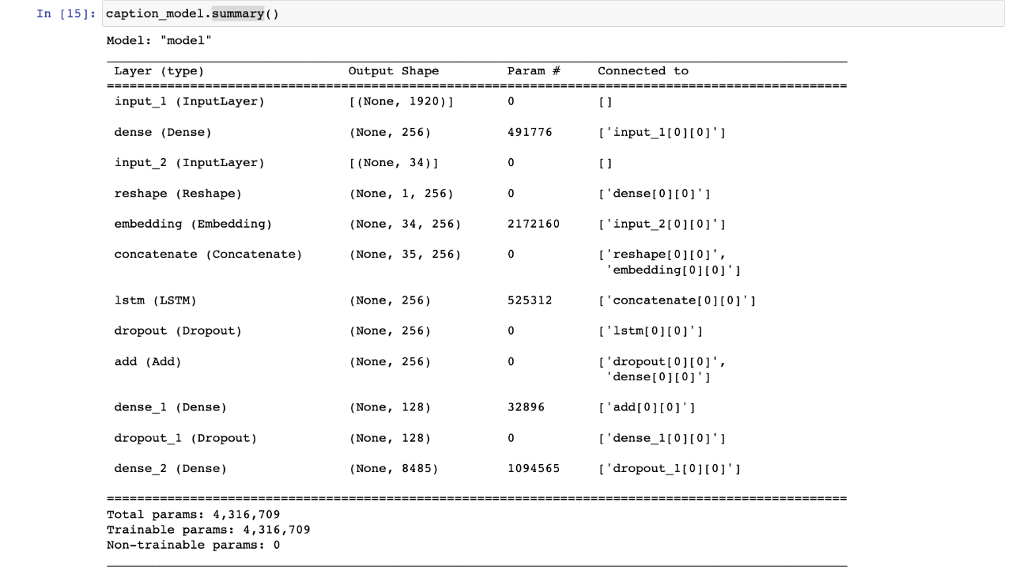
LSTM Model Structure

Slide 14
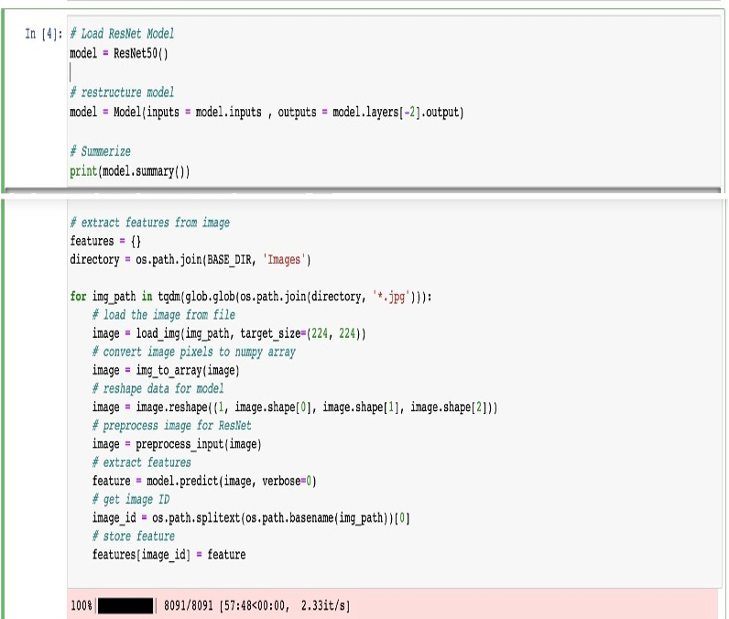
Feature Extraction ResNet Model
This code loads the ResNet50 model pre-trained on the ImageNet dataset and restructures it by removing the final classification layer to extract image features.
The extracted features are then saved in a dictionary with their corresponding image IDs.
The code also includes image preprocessing steps before extracting features and uses the tqdm library to display a progress bar while processing images.

Slide 15
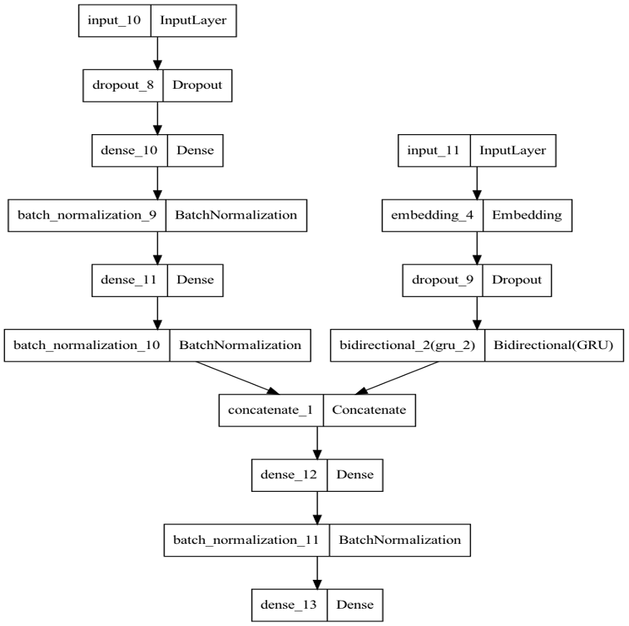
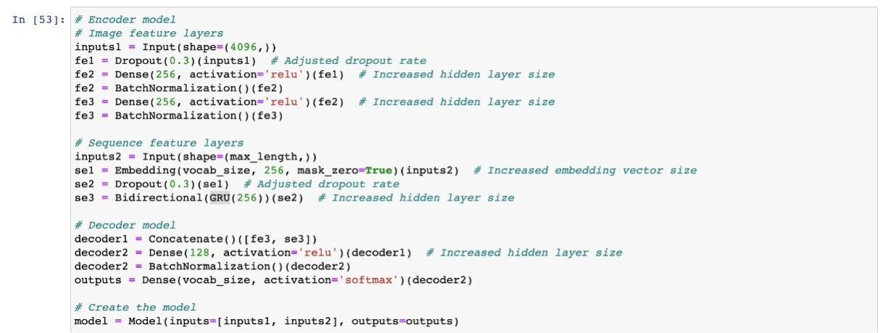
GRU Model Structure
Total params: 5,271,845
Trainable params: 5,270,565
Non-trainable params: 1,280

Slide 16
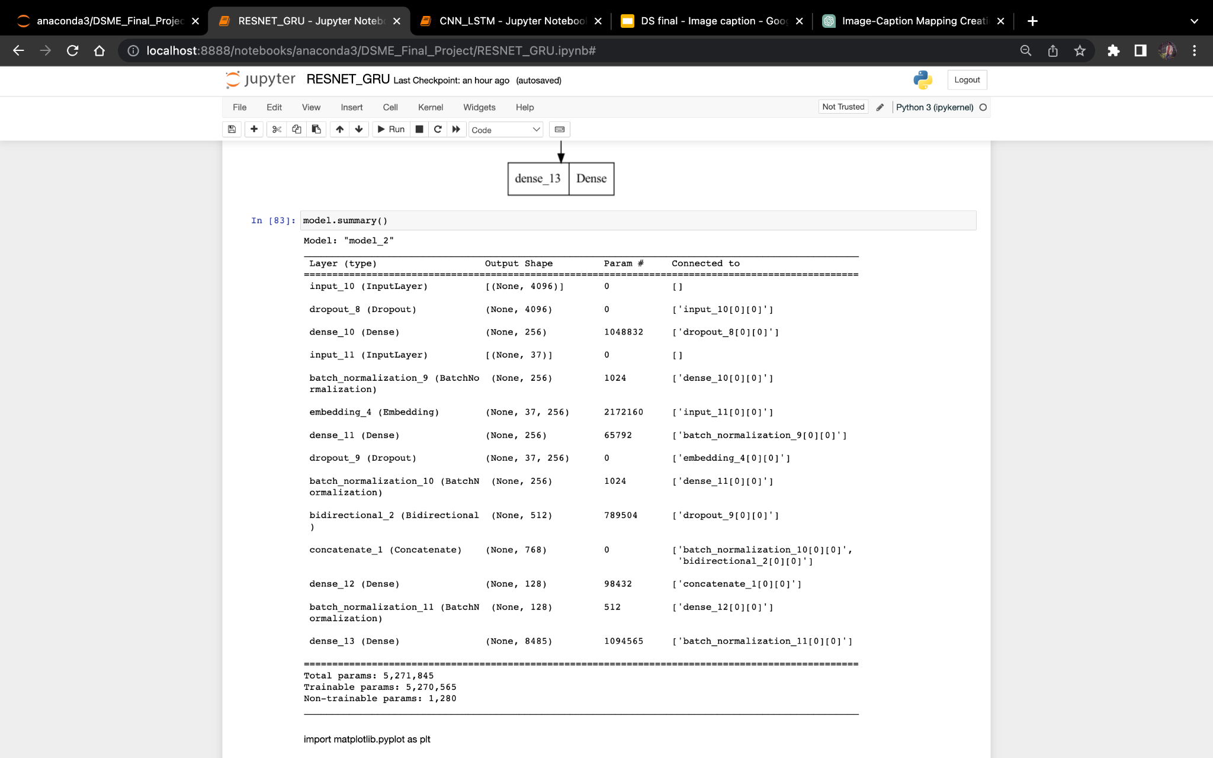
GRU Model Structure

Slide 17
Working with Models
Training the models with early stopping and history.
Create dynamic generate caption function.
Calculate Mean Bleu Score.
Visualization of test images with respective captions.
Comparison of both the models.

Slide 18
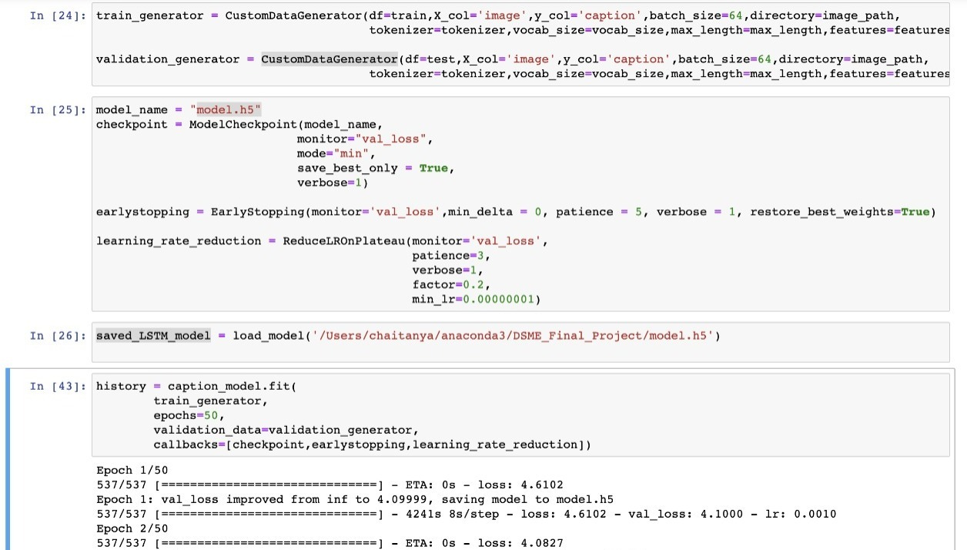
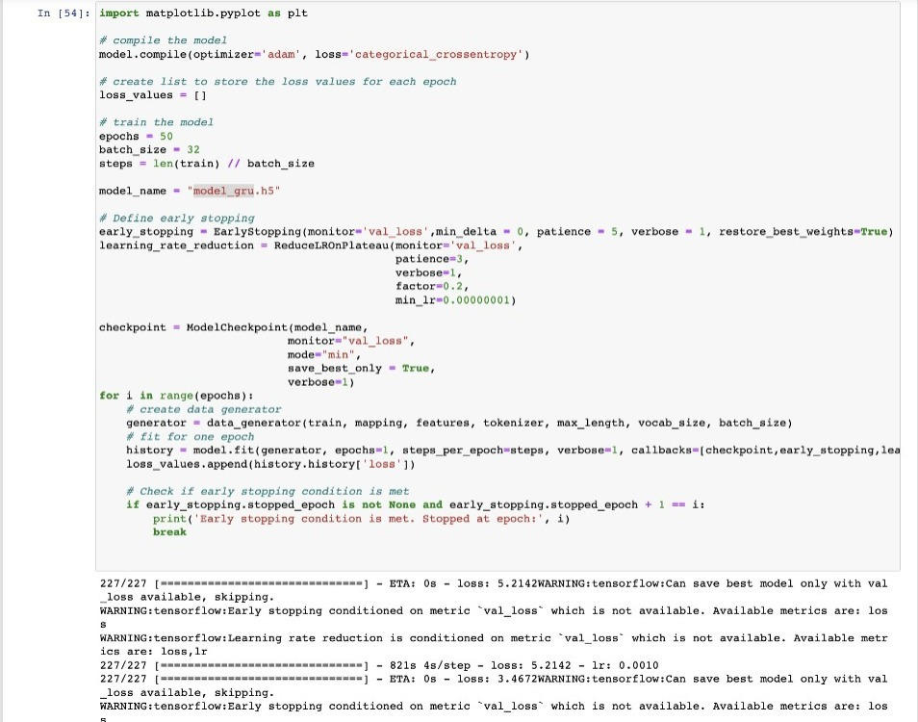
Training the models with early stopping and history.
CNN + LSTM
ResNet + GRU

Slide 19
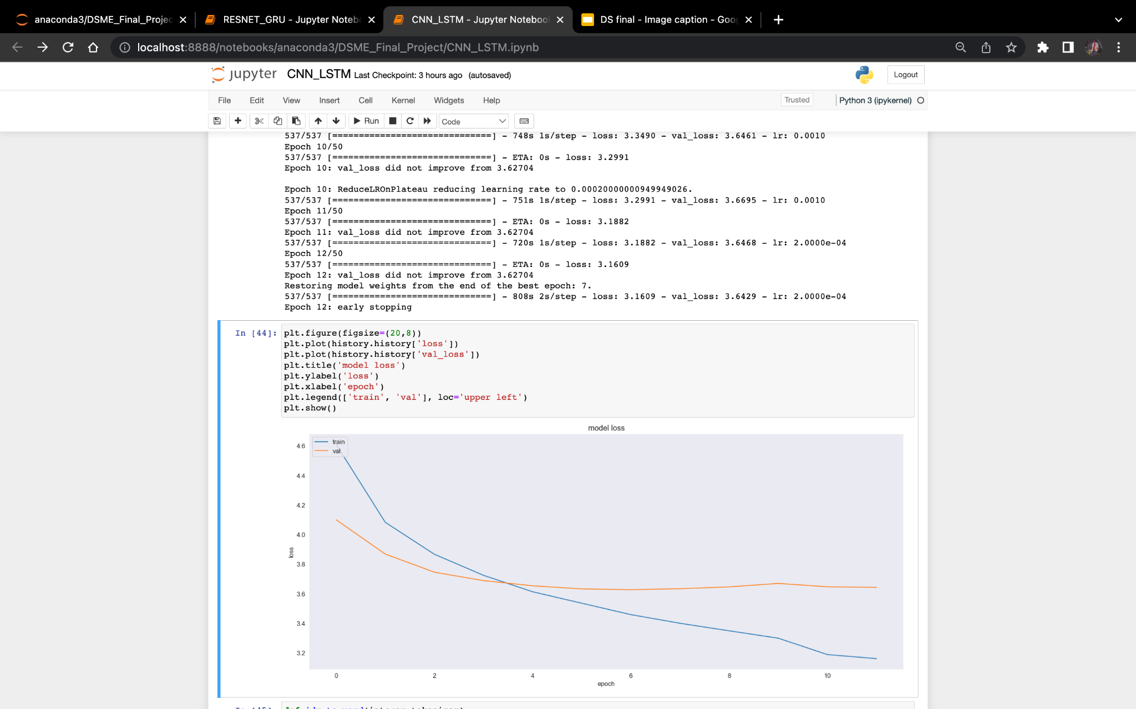
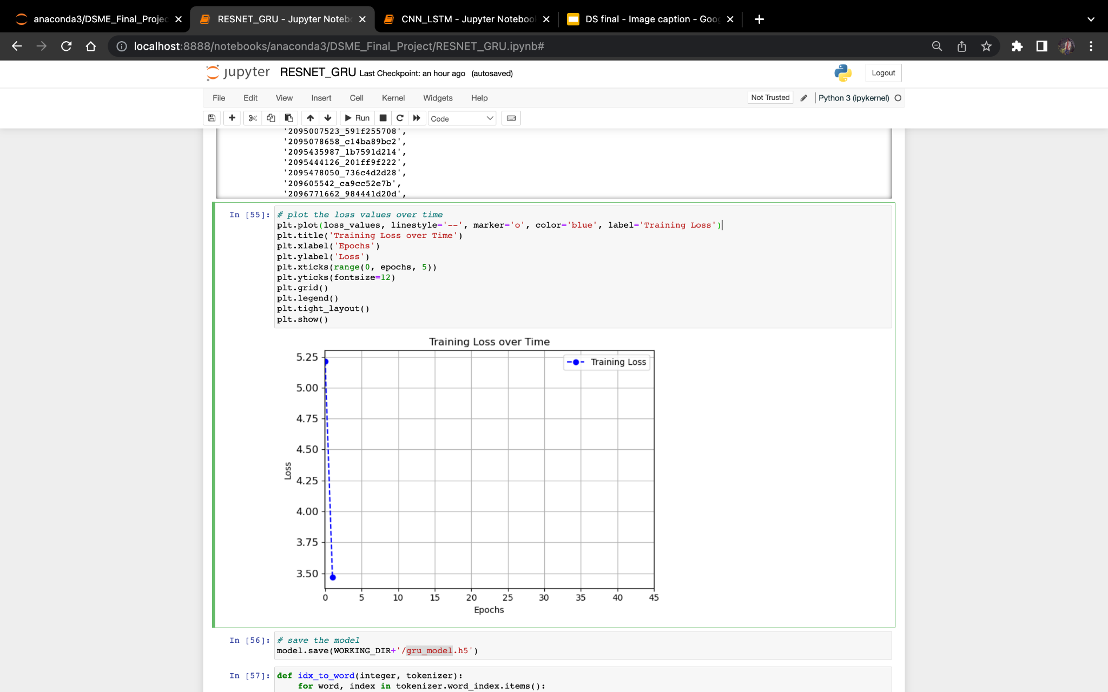
Traning and Validation Loss Curves
CNN + LSTM
ResNet + GRU

Slide 20
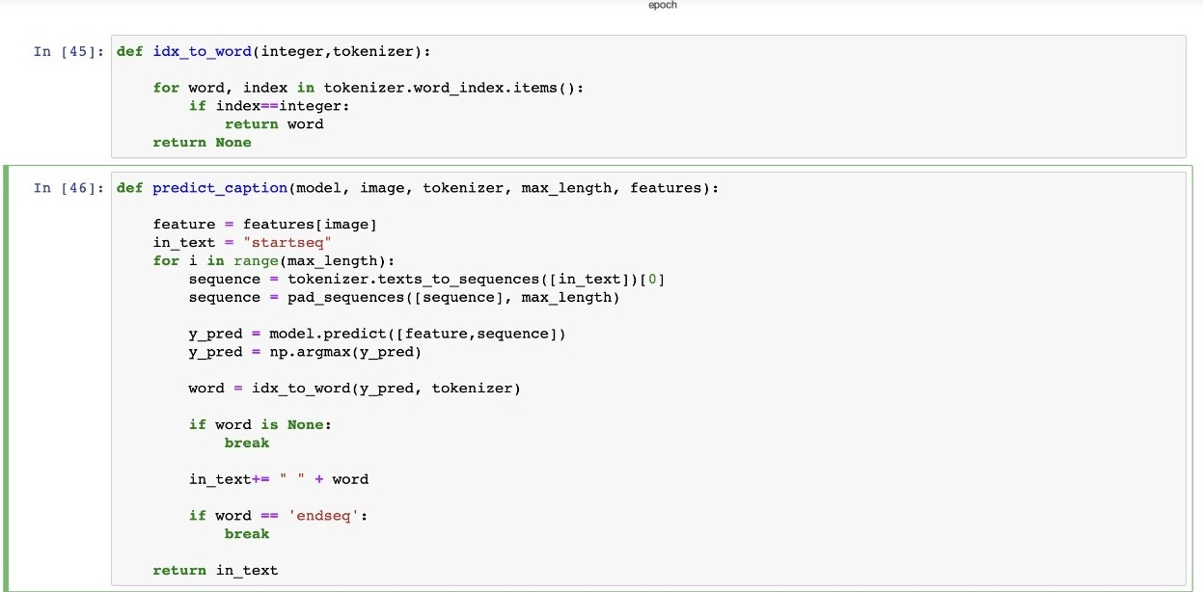
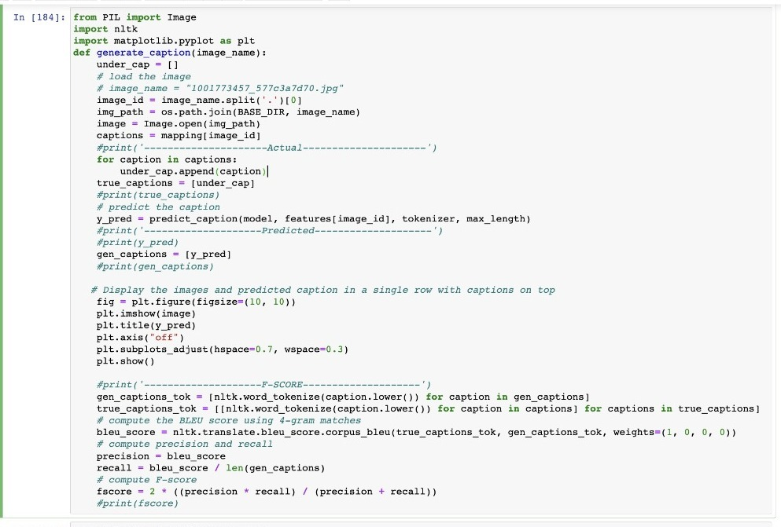
Training the models with early stopping and history.
CNN + LSTM
(Caption Prediction Code)
ResNet + GRU
(Caption Prediction Code)

Slide 21
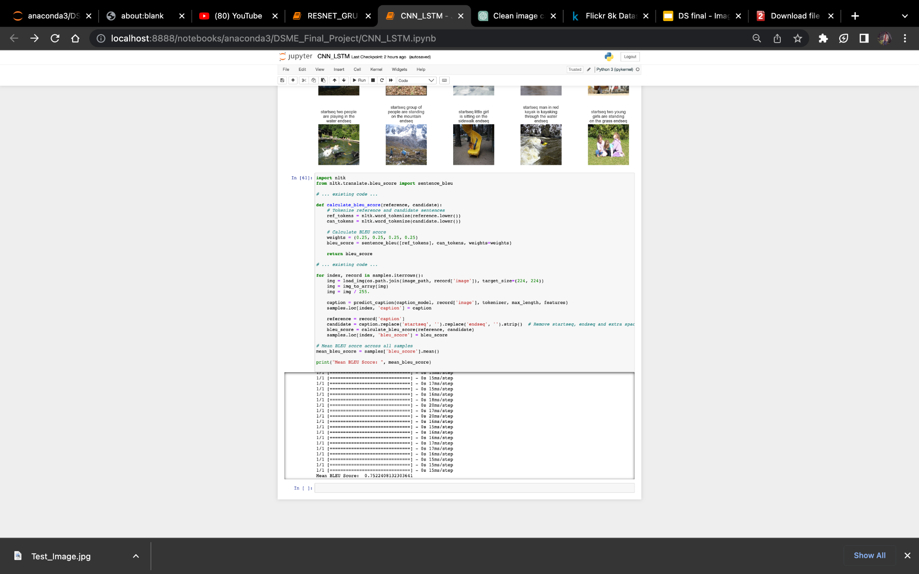
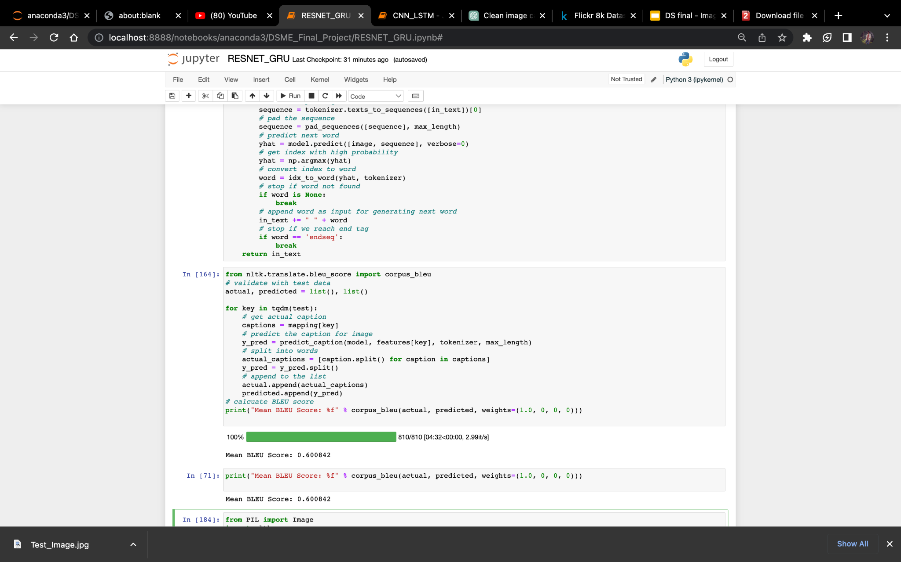
Bleu Score Comparison
CNN + LSTM
(Mean BLEU Score)
ResNet + GRU
(Mean BLEU Score)

Slide 22


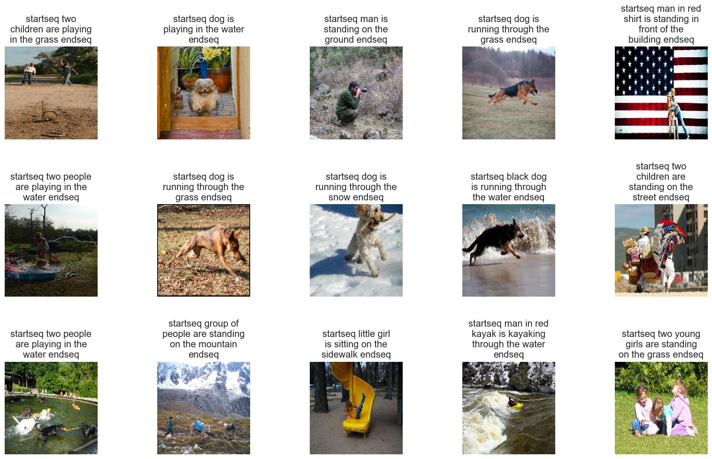
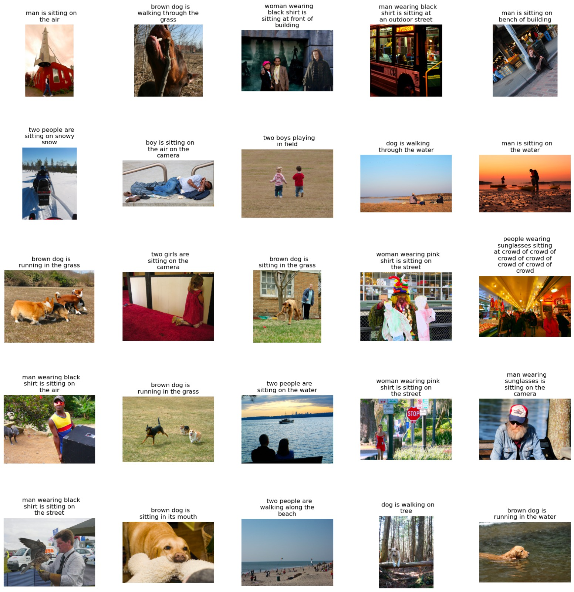
Results (on flicker dataset)
CNN+LSTM (Predicted Captions)
Resnet +GRU (Predicted Captions)

Slide 23
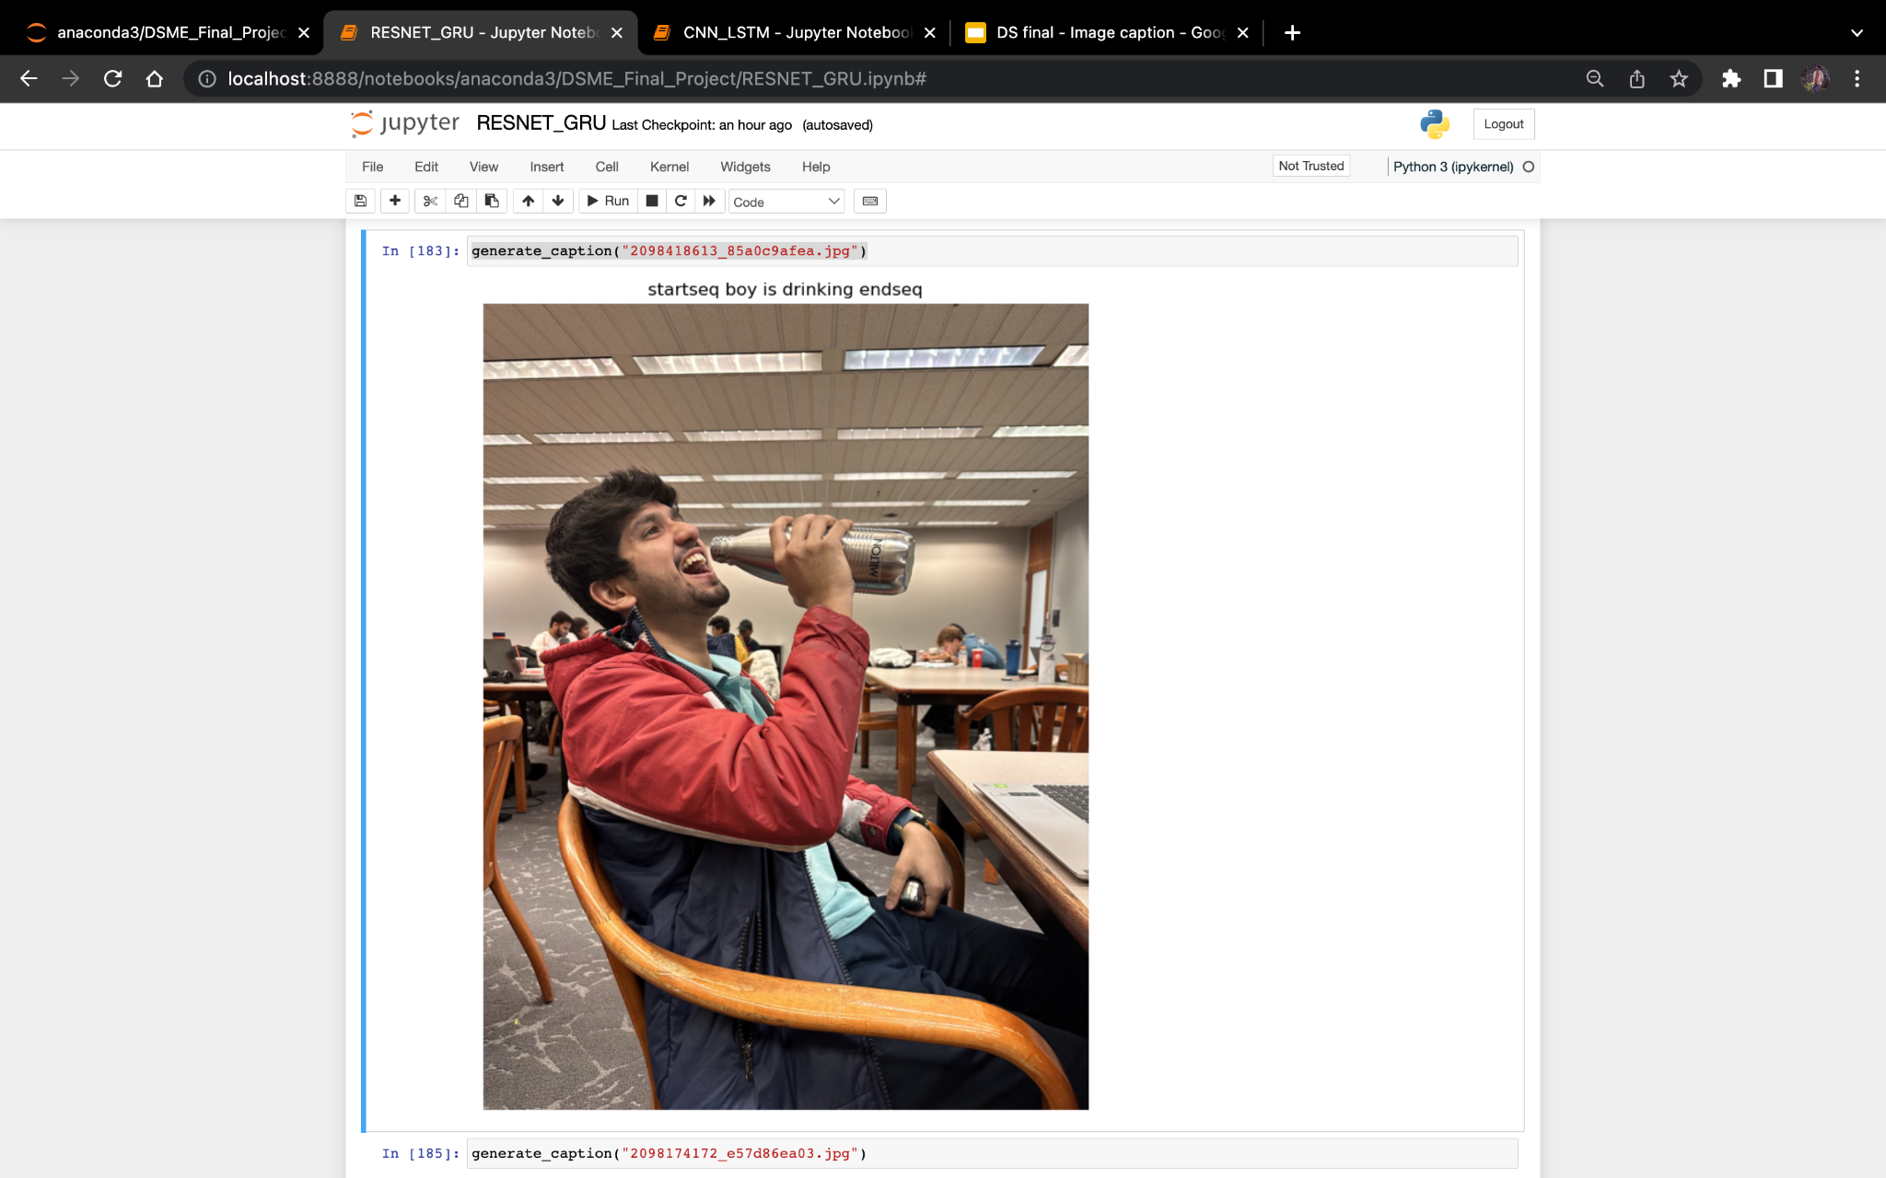
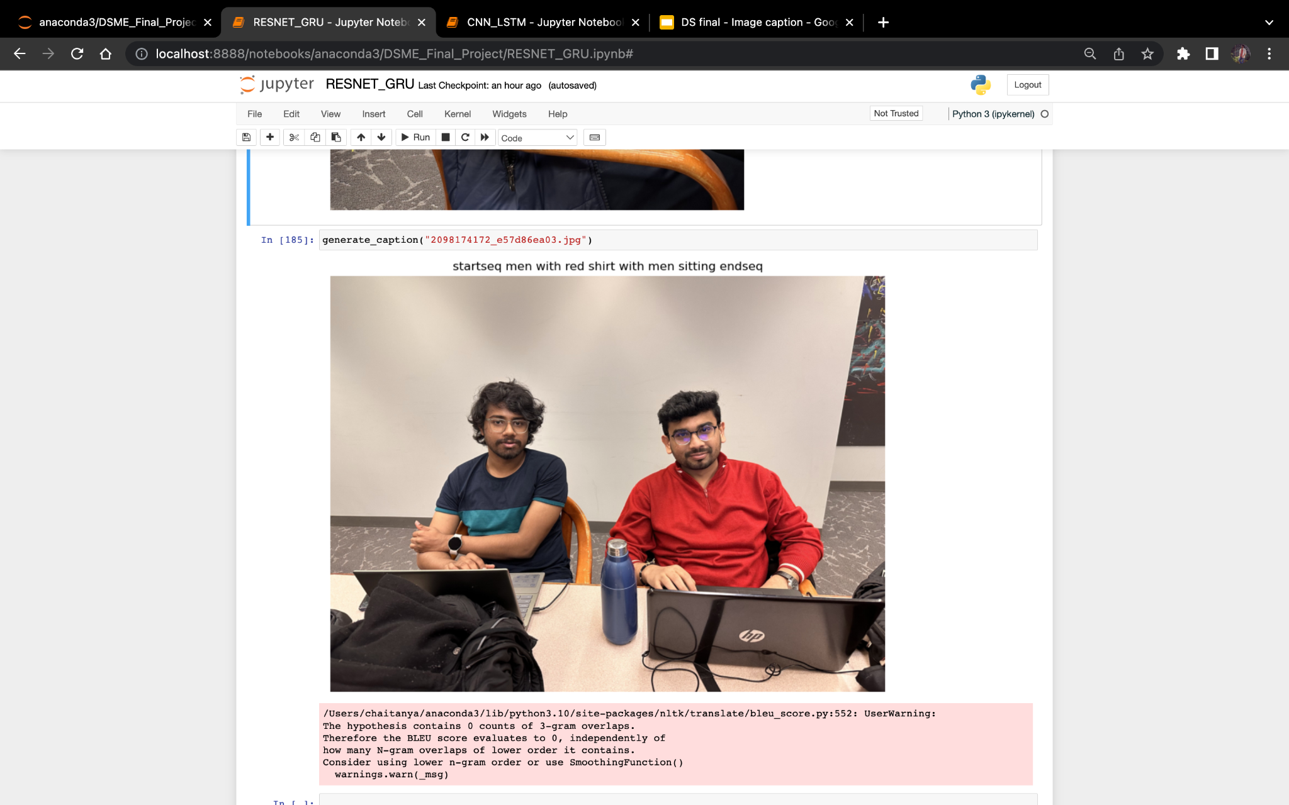
Results (Real Time Images)
Image captions are predicted by CNN + LSTM Model it is our best performing model

Slide 24


Conclusion
CNN + LSTM model works better in comparison to ResNet + GRU as LSTM takes context of the caption into consideration instead of just the sequence of words.
Mean BLEU score of CNN + LSTM is 75% where as BLEU Score of ResNet + GRU is 60% for all the weight combinations.
CNN + LSTM performs better in terms of defining the background and foreground features in comparison to ResNet + GRU

Slide 25

Thank you!

